Slide 1
Digital Speech Processing
Isolated Word Recognition System Based on DTW
Reporter：Jiahao Hu, Zhuo Liu
Instructor: Fei Chen

Slide 2
CONTENT
01 Background
02 Implementation
03 Future Improvement

Slide 3
01
Background

Slide 4
01
Background
What is speech recognition? Where can it be used? What are the benefits of using it?
The purpose of speech recognition is to make the machine understand the human language, that is, to recognize the speech content accurately in various situations.
Speech recognition has broad application prospects in industry, military, transportation, medicine and civil areas, such as voice-controlled telephone switching, voice dialing system, smart home and so on.
Speech recognition technology will greatly improve the human-machine interface, improve the automation of information processing, and have great social and economic benefits.
Speech recognition is one of the key technologies to change the future life style of human beings.

Slide 5
02
Implementation

Slide 6
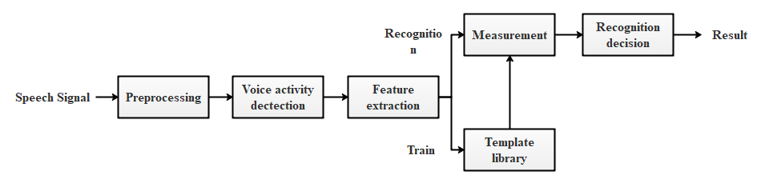
02
Implementation

Slide 7
02
Implementation
Preprocessing:
pre-emphasis filter
Voice activity dectection:
Speech signal is divided into four segments: silent segment, transition segment, voice segment and end segment.

Slide 8
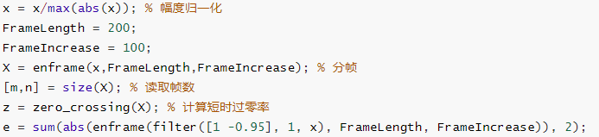
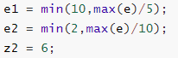
02
Implementation
Voice activity dectection:
Speech signal is divided into four segments(states): silent segment, transition segment, voice segment and end segment.
Two important measured value: short-time energy and zero-crossing rate.
Set the low and high threshold.
How to judge what's the segment the current signal locates in.

Slide 9
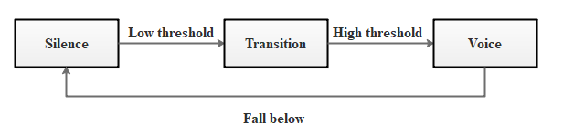
02
Implementation
The default state is slient state.
In the silent state, if the energy or zero-crossing rate exceeds the low threshold, it should record the starting point and enter the transition section.
In the transition state, because the energy and zero-crossing parameters are low, we can't be sure if the current signal is really in the voice segment.
How to make sure the current signal is in the voice segement?
If the energy parameters in the transition section exceed the high threshold, the signal is in the voice segement.
But as long as the values of both parameters fall below the low threshold, the current state will be restored to the silent state.
How to judge what's the segment(state) the current signal locates in?

Slide 10
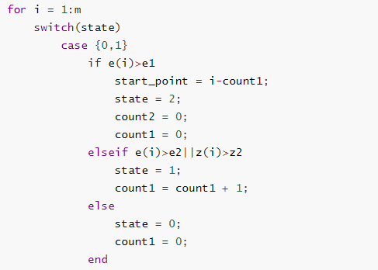
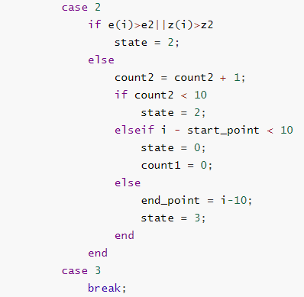
02
Implementation

Slide 11
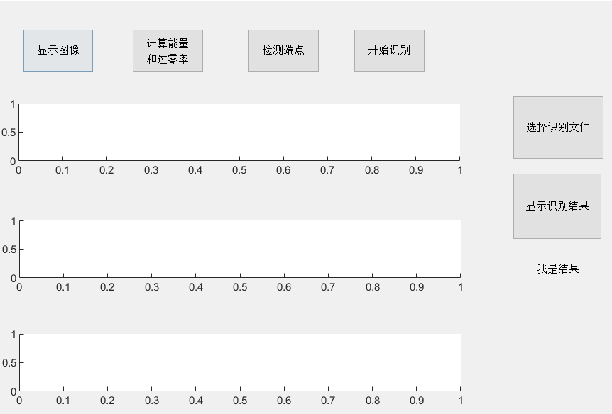
02
Implementation

Slide 12
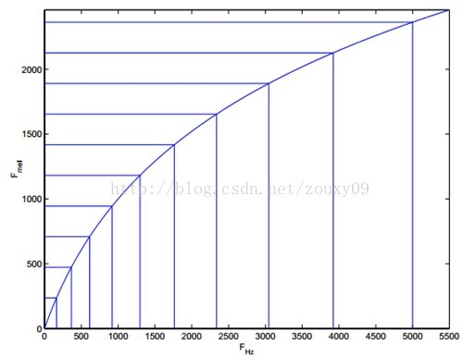
02
Implementation
What's the extracted parameters?
Mel frequency cepstrum coeficience (MFCC)
How to get Mel frequency cepstrum coeficience?
Obtaining Spectrogram
Pass through Mel filter
Logarithm
IDFT/DCT

Slide 13
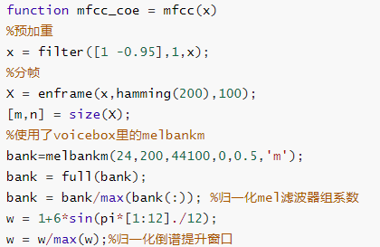
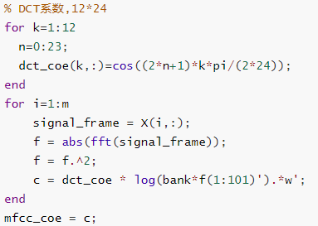
02
Implementation

Slide 14
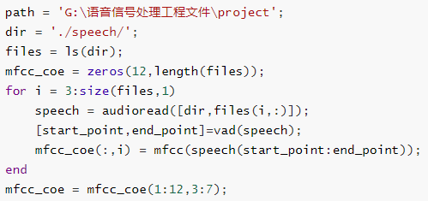
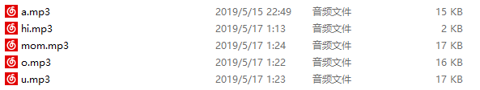
02
Implementation
How to extract the feature of library?
Read the files in the voice library and extract MFCC.

Slide 15
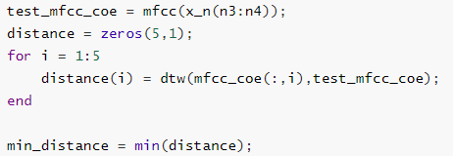
02
Implementation
What speech do we use to be recognition? How to choose our decision method?
A speech signal with noise. (We have less training set).
Dynamic Time Warping(DTW)
Hidden Markov Model(HMM)
Vector Quantization(VQ)
ANN...

Slide 16
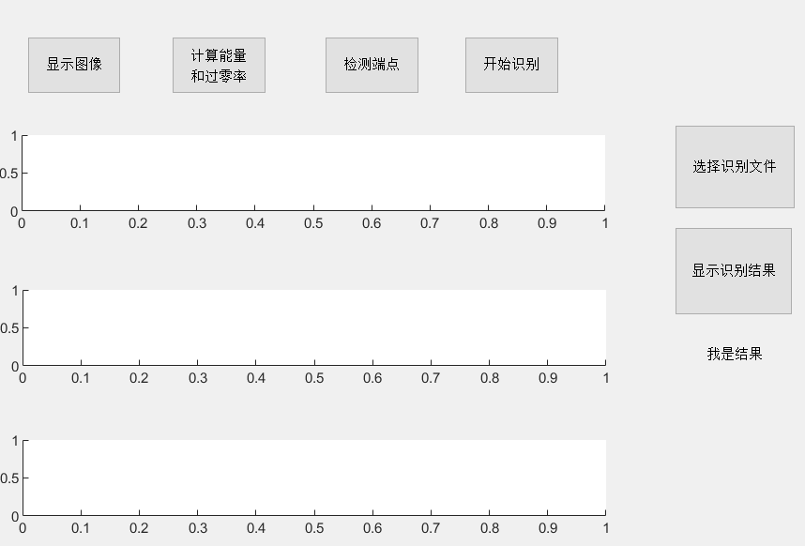
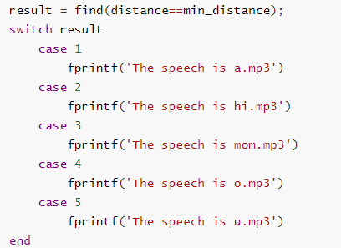
02
Implementation

Slide 17
03
Future Improvement

Slide 18
03
Future Improvement
Use a larger training set to achieve wider recognition.
Compare between different training and recognition method
such as DTW, HMM, VQ, ANN/HMM, DNN, and CTC.

Slide 19
04
Reference
胡光锐. (1994). 语音处理与识别.
刘幺和，宋庭新. (2008). 语音识别与控制应用技术.
张雪英. (2010). 数字语音处理及MATLAB仿真.
王永琦. (2013). MATLAB与音视频技术.

Slide 20
THANK YOU FOR WATCHING

